Slide 1
Scissors, Paper Rock Game
By: Atullya Maharjan

Slide 2
Scissor, Paper Rock Game
Scissor Paper Rock (also known as Rock Paper Scissors) is a two-player game where each player simultaneously chooses one of three possible hand shapes (scissors, paper, or rock). The players' choices are then compared, and the winner is determined based on the following rules:
Scissors beats Paper: If both players choose scissors, the game is a draw.
Paper beats Rock: If both players choose paper, the game is a draw.
Rock beats Scissors: If both players choose rock, the game is a draw.
The game is quick, easy to learn, and does not require any special equipment. It is often used as a way to settle disputes or make decisions in a variety of situations, as it is a simple game of chance.

Slide 3
Objectives
To create an interactive computer game in C++ that allows two players to play the game of “Scissors, Paper, Rock”
To provide a user-friendly interface that allows the user to interact with the game.
To create a fun and engaging game that requires minimal user input and produces a random outcome.

Slide 4
Key Feature of the game are as follows:
1. Input: The game requires user input from the player to choose either scissor, paper, or rock.
2. Randomization: The computer needs to generate a random number and assign it either scissor, paper, or rock.
3. Output: The game should output the result of the game after comparing the user input against the random number.

Slide 5
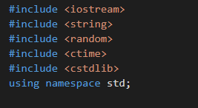
For implementing these features in C++, I first included the header files <iostream>, <string>, <random>,<ctime>and <cstdlib>, which include the necessary functions for input and output, strings, and random number generation respectively.

Slide 6
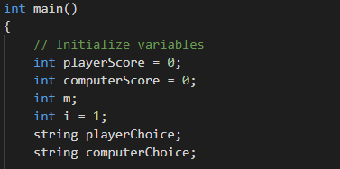
Then I defined the different possible inputs as strings, using the string data type. I used the rand() function to generate a random number and used if-else statement to assign the input based on the random number generated.

Slide 7
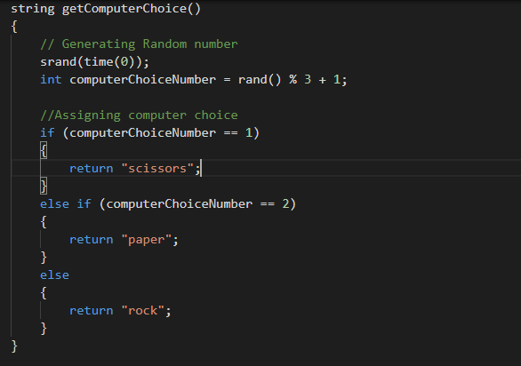

Slide 8
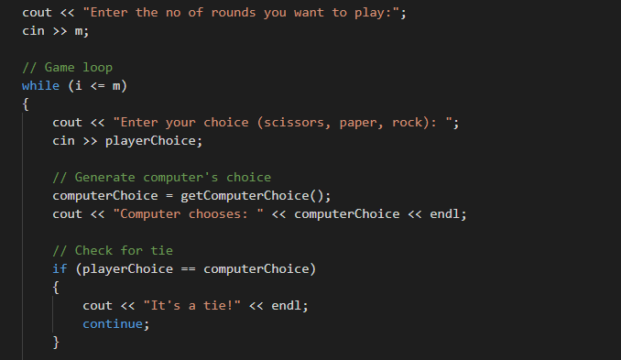
Next, I used an if-else statement to compare the user input and the computer’s input and output of the result of the game. Finally, I used a while loop to keep the game running for the n numbers of rounds and displayed the final score.

Slide 9
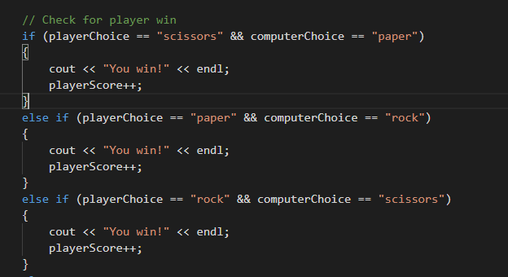
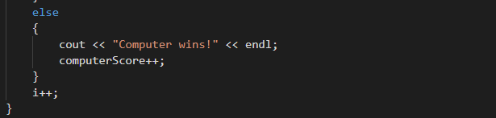

Slide 10
